Slide 1
About AADOCR
Notes:
The American Association for Dental, Oral, and Craniofacial Research (AADOCR) is the leading professional community for multidisciplinary scientists who advance dental, oral, and craniofacial research. Previously the American Association for Dental Research, the 3,000-member organization connects the scientific community of professionals who champion research that contributes to overall health and well-being.

Slide 2
AADOCR Mission Drive dental, oral, and craniofacial research to advance health and well-being.
Notes:
The AADOCR Mission Statement is: Drive dental, oral, and craniofacial research to advance health and well-being.

Slide 3
AADOCR Vision Oral health through discovery and dissemination.
Notes:
The AADOCR Vision Statement is: Oral health through discovery and dissemination.

Slide 4
IADR Values
Scientific Excellence: IADR values science conducted at the highest possible levels of rigor, innovation and ethics, across disciplines, from discovery science to clinical implementation to global population health.
Social Responsibility: IADR values the pursuit of science to improve health and well-being for all people, to reduce health inequalities and inequities, and proactively takes actions and positions to improve health.
Scientific Community: IADR values a diverse and inclusive scientific workforce, promotes work-life balance, and supports educational activities and mentoring networks to develop the next generation of scientists.
Notes:
The IADR Core Values are: Scientific Excellence, Social Responsibility, and Scientific Community

Slide 5
AADOCR Board of Directors
President Alexandre Vieira, University of Pittsburgh, PA
President-elect Effie Ioannidou, University of Connecticut, Farmington
Vice-president Jennifer Webster-Cyriaque, NIDCR, Bethesda, MD, USA
Immediate Past President Jane Weintraub, University of North Carolina, Chapel Hill
Treasurer Ana Bedran-Russo, Marquette University, Milwaukee, WI
JDR Editor-in-Chief Nicholas Jakubovics, Newcastle University, England
JDR CTR Editor-in-Chief
Jocelyne Feine, McGill University, Montreal, Quebec, Canada
Patient Advocate Representative Paige Falion, Association of Maternal and Child Health Programs, Washington, DC
Members Brian Foster, The Ohio State University, Columbus
Mark Heiss, GC America, Inc.
Members-at-Large Erin Bumann, University of Missouri, Kansas City
Ben Chaffee, University of California, San Francisco Sheila Riggs, University of Minnesota, Minneapolis
Student Representatives Shawn Hallett, University of Michigan, Ann Arbor
James Seung Jin Jang, University of Florida, Gainesville
Chief Executive Officer Christopher H. Fox, IADR/AADOCR, Alexandria, VA
Notes:
This is a list of the 2022-23 AADOCR Board of Directors.

Slide 6
AADOCR Membership
AADOCR is the leading professional community for multidisciplinary scientists who advance dental, oral, and craniofacial research.
Notes:
Discover, network, and advance your career with an IADR/AADOCR membership! Join our extensive and valuable network of 3,000 members in the US and over 8,300 members worldwide. Whether you are a researcher, student, or other individual interested in dental, oral, and craniofacial research, the IADR/AADOCR welcomes you as a member.

Slide 7
AADOCR Membership Breakdown
Member: | 1,556
Retired Member: | 280
Student Member: | 759
Affiliate Member: | 41
Total Membership: | 2,636
(As of September 18, 2023)

Slide 8
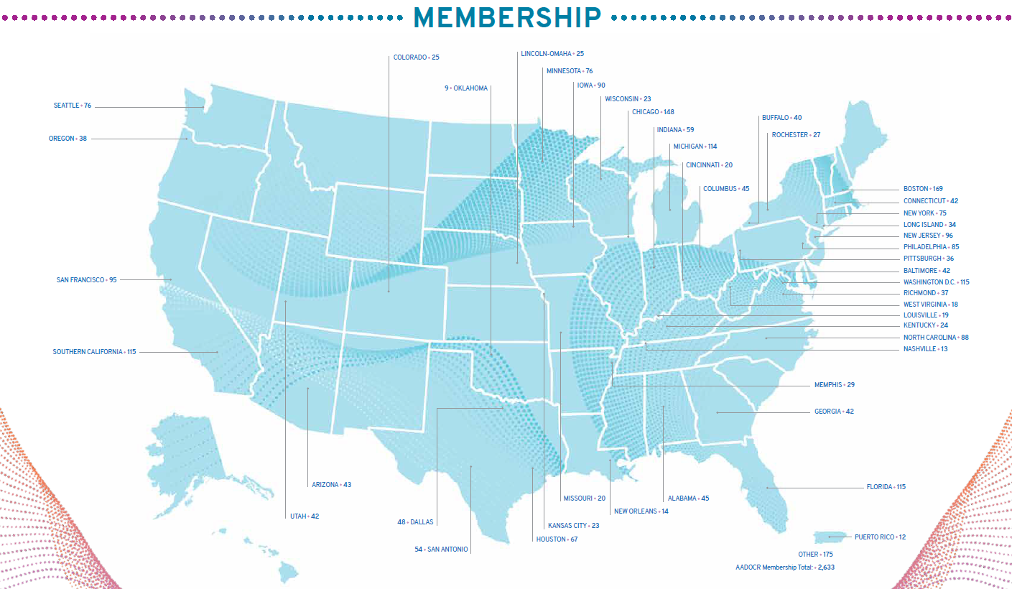
Notes:
This is the AADOCR membership breakdown by Section as of December 31, 2022.

Slide 9
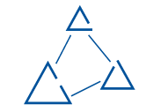
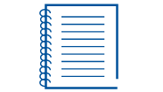
AADOCR Membership Benefits
Online Community Engage with members throughout the year
Publications JDR, JDR CTR, and Advances in Dental Research
IADR Webinar & CE On Demand Library Explore a huge library of educational content
Scientific Groups & Networks Connect with colleagues in your specialty area
Meetings Members receive registration discounts
Awards Over $460,000 in awards and fellowships funded in 2022
Advocacy Pushing for DOC research funding within the federal agencies
Career Center Find your next great job or star employee
Member Directory Find members in your area and make lifelong connections
Notes:
An IADR/AADOCR membership offers many benefits including access to the online IADR Community and AADOCR Community, IADR Webinar Connect, publications, advocacy, discounts on meeting registrations, presentation, and awards/fellowship opportunities, access to the IADR CE On Demand library and IADR Abstract Archive, the Science Advocate newsletter, membership in IADR Scientific Groups or Networks, and much more.

Slide 10
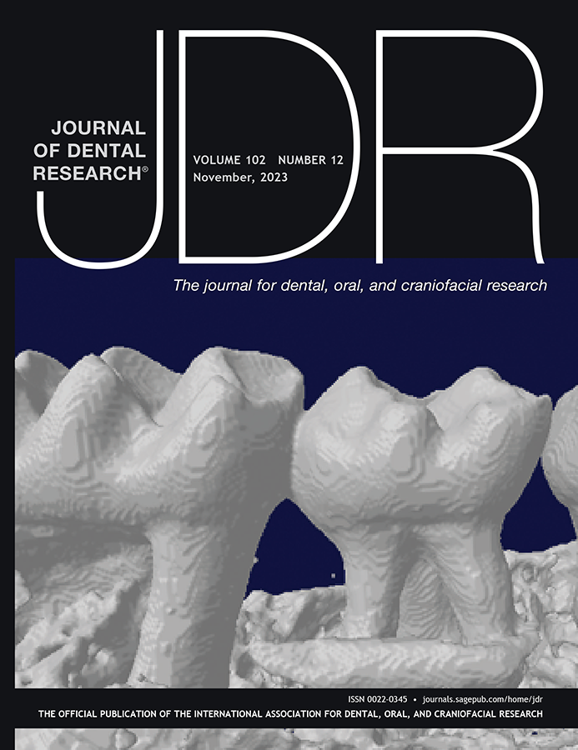
Journal of Dental Research
Editor-in-Chief: Nicholas Jakubovics
Journal Citation Reports™ results for the JDR:
2-year Journal Impact Factor™: 7.6, ranking #3 of 91 journals
5-year Journal Impact Factor™: 7.6, ranking #5 of 91 journals
Eigenfactor: 0.01345, ranking #3 of 91 journals
Total citations: 25,849, ranking #1 of 91 journals
Article Influence Score: 1.638, ranking #5 of 91 journals
Journal Citation Indicator: 2.86, ranking #3 of 156 journals
Published manuscripts appear in print and OnlineFirst, by which forthcoming articles are published online before they are scheduled to appear in print.
www.iadr.org/jdr
Follow the JDR on Twitter @JDentRes!
Notes:
The Journal of Dental Research (JDR) 2-year Journal Impact Factor™ is over 8 for the first time at 8.924, ranking #3 of 92 journals in the “Dentistry, Oral Surgery & Medicine” category, and the JDR 5-year Journal Impact Factor™ is over 8 for the first time at 8.463, ranking #4 of 92 journals. The JDR also ranks #1 of 92 journals in total citations and Eigenfactor, #3 in the new Journal Citation Index and #4 in Article Influence Score. This news comes from the 2022 Journal Citation Reports™.

Slide 11
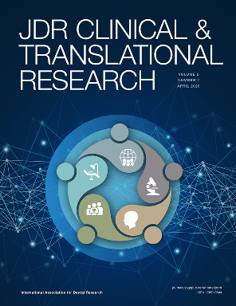
JDR Clinical & Translational Research
Editor-in-Chief: Jocelyne S. Feine
Associate Editor: Vanessa Muirhead
JDR Clinical & Translational Research received its first Journal Impact Factor™ in 2023!
Journal Impact Factor™: 3.0
Eigenfactor™: 0.00148
Immediacy Index: 0.500
Journal Citation Indicator: 1.07
Total 2022 citations: 786
Average time from submission to first decision: 29.8 days
Average time from acceptance to online publication: 41 days
www.iadr.org/jdrctr
Follow the JDR CTR on Twitter @JDRClinTransRes!
Notes:
The JDR CTR has been accepted for inclusion in MEDLINE!
MEDLINE, created by the U.S. National Library of Medicine (NLM), is the authoritative bibliographic database containing citations and abstracts in the fields of medicine, nursing, dentistry, veterinary medicine, health care systems and preclinical sciences from around the world and is used internationally by clinicians, researchers and policy makers to access the world's biomedical research literature. A distinctive feature of MEDLINE is that the records are indexed with the NLM Medical Subject Headings (MeSH®). MEDLINE is the primary component of PubMed® — a database with over 29 million citations for life sciences and biomedical literature.

Slide 12
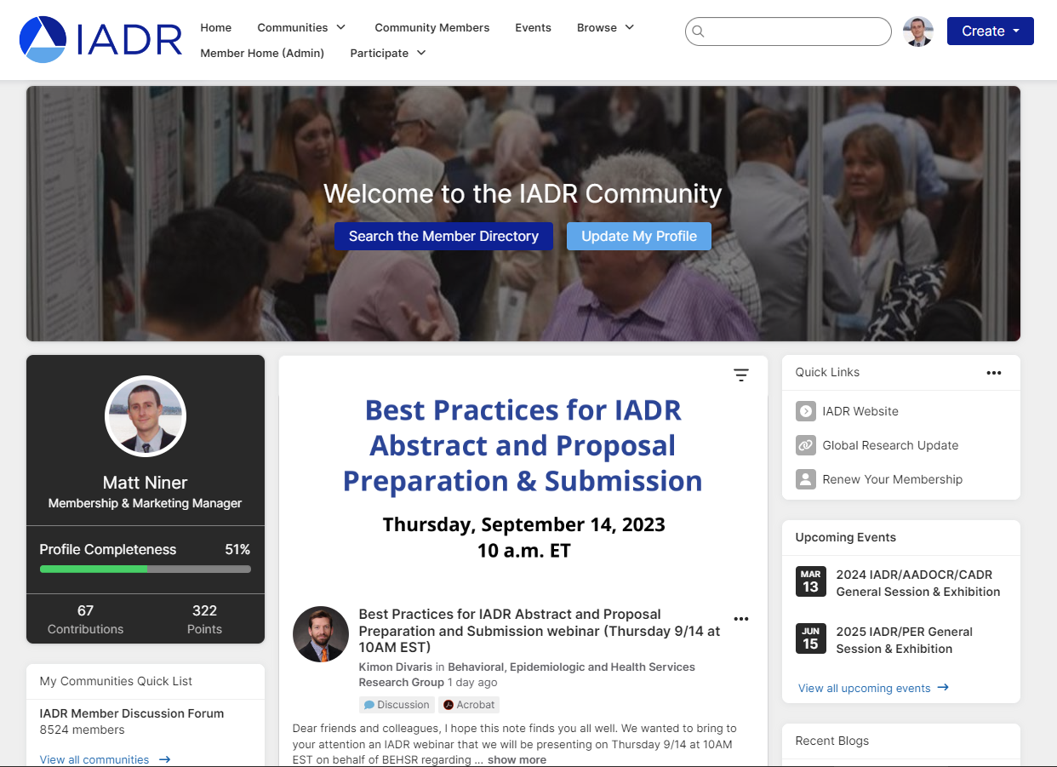
IADR Community
An online platform where IADR members can engage throughout the year.
The IADR Community has been upgraded!
With a new design, a more intuitive interface, and improved search functionality, it’s now easier than ever for IADR members to engage throughout the year.
Notes:
Join the IADR Community. The IADR Community is an online hub to meet and discuss research and other topics with your colleagues.

Slide 13
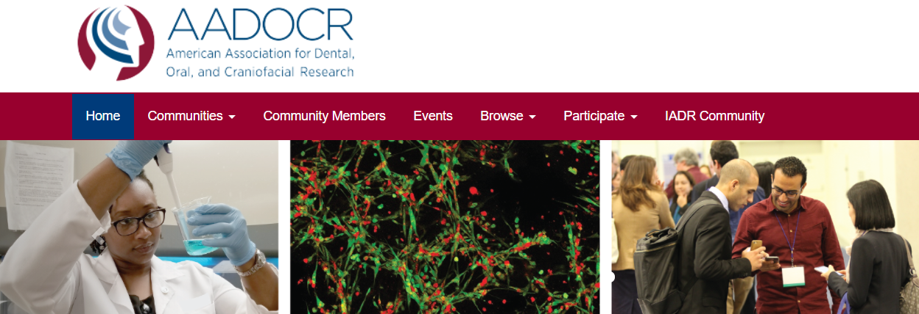
AADOCR Community
The AADOCR Community allows members to network, share, post, and comment on issues specific to the AADOCR.
Notes:
The new AADOCR Community allows members to network, share, post, and comment on issues specific to the AADOCR. Over the coming months the AADOCR will also launch smaller communities for AADOCR committees, patient advocates, and others. To access the AADOCR Community, visit the IADR Community, click “ Communities” in the navigation bar and click “ My Communities.”

Slide 14
IADR Webinar & CE On Demand Library
Attend live webinars where you can interact with speakers or view recordings of past webinars and cutting-edge presentations from IADR and AADOCR meetings.
Notes:
The new IADR Webinar Connect Platform allows IADR members to participate in live webinars and view our growing list of past webinars on demand!

Slide 15
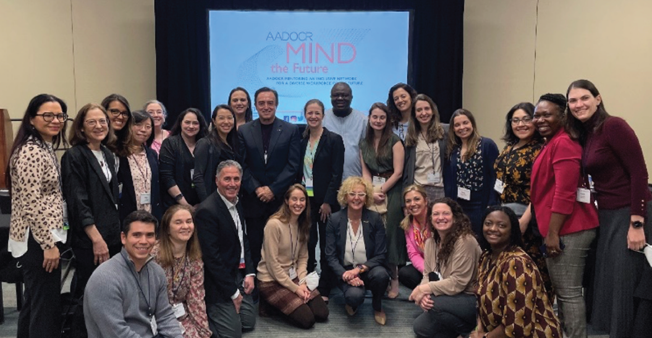
AADOCR MIND the Future
Mentoring an Inclusive Network for a Diverse Workforce of the Future
The first in-person AADOCR MIND the Future Business Meeting was held at the 2022 AADOCR Annual Meeting & Exhibition
The AADOCR MIND the Future program is open to early-career investigators and individuals from underrepresented racial and ethnic groups, individuals with disabilities, and individuals from disadvantaged backgrounds.
Notes:
MIND the Future will build a vibrant and inclusive community of investigators whose participation is vital to advancing dental, oral, and craniofacial research and improving the oral health of our nation. The primary goal of this NIDCR-funded program is to establish a mentoring network that will support a diverse pool of early-career investigators, including individuals from diverse backgrounds, in developing independent research careers dedicated to improving dental, oral, and craniofacial health. (NIH Grant No. 1UE5DE029439).

Slide 16
AADOCR National Student Research Group
The AADOCR NSRG is a student-run organization whose main purpose is to foster an environment in every dental school whereby students interested in enriching their dental education through research are encouraged to do so.
All AADOCR Student members are part of the AADOCR NSRG and are eligible to participate in NSRG activities.
The AADOCR NSRG provides students with opportunities to present research, apply for awards, and network at IADR/AADOCR meetings and throughout the year.
Learn more at www.iadr.org/AADOCR/Students.
Notes:
The NSRG is a Scientific Group of the AADOCR composed of a network of self-governing local Student Research Group (SRG) chapters at dental schools and is led nationally by officers elected through a majority of votes from all members. All AADOCR student members are part of the AADOCR NSRG and are eligible to participate in their programs and activities.
Student members must join at least one IADR Group/Network and may join up to a total of three IADR Groups/Networks at no charge.

Slide 17
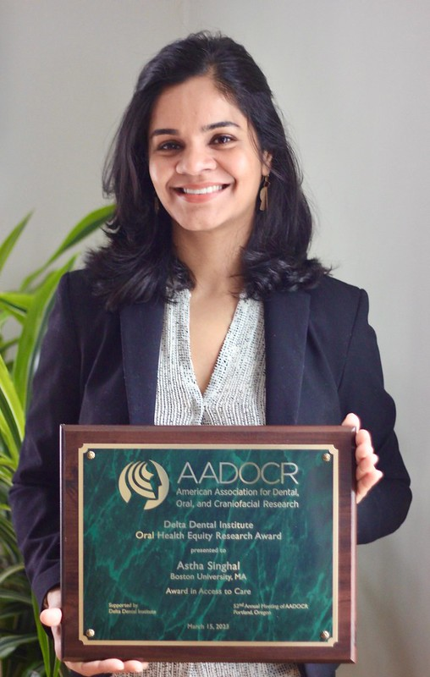
Awards and Fellowships
There are more than 40 awards and fellowships in various categories, including student awards.
IADR Distinguished Scientist Awards
17 different categories
AADOCR Bloc Travel Grant Award
AADOCR Student Research Day Award
AADOCR Student Research Fellowships
SCADA
Hatton Competition
AADOCR: Junior, Senior, Post-doctoral
IADR: Junior, Senior Clinical, Senior Basic Science
Scientific Group Awards
Notes:
Photo: AADOCR/DDI Oral Health Equity Research Award Winner
Astha Singhal Boston University, MA

Slide 18
IADR Scientific Research Groups/Networks
Scientific Groups (25)
Behavioral, Epi & HSR
Cariology Research
Craniofacial Biology
Dental Anesthesiology & Special Care Research
Dental Materials
Diagnostic Sciences
Education Research
Geriatric Oral Research
Implantology Research
Microbiology/Immunology
Lasers & Biophotonics
Mineralized Tissue
Neuroscience/TMJ
Nutrition Research
Oral & Maxillofacial Surgery
Oral Health Research
Oral Medicine & Pathology
Orthodontics Research
Pediatric Oral Health Research
Periodontal Research
Pharmacology, Therapeutics &Toxicology
Prosthodontics Pulp Biology & Regeneration
Salivary Research
Stem Cell Biology
Networks (10)
Clinical and Translational Science
Digital Dentistry Research Network
e-Oral Health Network
Evidence-based Dentistry
Global Oral Health Inequalities Research
International Network for Orofacial Pain and Related Disorders Methodology (INfORM)
Minimally Invasive Dentistry Network
Network for Practice-based Research
Student Training and Research (STAR)
Women in Science Network
Notes:
This is a list of the IADR Scientific Groups and Networks. IADR/AADOCR members may enjoy complimentary membership in one IADR Scientific Group or Network and Student members can join up to three IADR Scientific Groups or Networks as part of their Student membership. Please be active in at least one.

Slide 19
Government Affairs and Advocacy
AADOCR’s government affairs and advocacy activities include:
Advancing dental, oral, and craniofacial research and funding among Congress and the administration.
Analyzing legislation and regulatory notices and ensures dental, oral and craniofacial research are represented.
Engaging AADOCR members in grassroots advocacy efforts.
Co-hosting a “Capitol Hill Day” with the Friends of National Institute for Dental and Craniofacial Research to secure funding increases for oral health research agencies.
Notes:
The Association actively engages with members of Congress, the administration and officials at the National Institutes of Health to promote AADOCR policy positions. AADOCR’s primary focus is increasing funding for the National Institutes of Health and the National Institute of Dental and Craniofacial Research so that our members are provided adequate resources to improve oral health through dental, oral and craniofacial research activities, but we also support oral health efforts across the federal research enterprise. The Association is an active partner with the ADA, ADEA and other dental groups and is involved in a number of coalitions focusing on areas of interest to AADOCR and our members. Beyond our external-facing work, a core part of our role is also to provide AADOCR members with information about potential implications of federal legislation and policies and give them the tools they need to respond to those that may impact their work.

Slide 20
The FNIDCR Patient Advocacy Council is comprised of non-profit organizations who work together to:
Support oral health research and NIDCR.
Transfer oral health research from bench to bedside.
FNIDCR increases efficiency, eliminates duplication of advocacy efforts, provides a stronger voice for patient advocates, and provides greater support to the NIDCR director.
Notes:
The Friends of NIDCR Patient Advocacy Council is comprised of non-profit organizations who work together to 1) support oral health research and NIDCR and 2) transfer oral health research from bench to bedside.

Slide 21
FNIDCR Patient Advocacy Council
Adenoid Cystic Carcinoma Research Foundation
American Autoimmune Related Diseases Association
American Behcet’s Disease Association
American Chronic Pain Association
American Cleft Palate-Craniofacial Association
Ameriface
Association of Maternal & Child Health
CCD Smiles
Children’s Craniofacial Association
Ear Community, Inc.
FACES: The National Craniofacial Association
Fibrous Dysplasia Foundation, Inc.
Greater Tampa Bay Oral Health Coalition
HOPE: For Burning Mouth Syndrome
International Foundation for Autoimmune Arthritis
International Pemphigus & Pemphigoid Foundation
Lupus and Allied Diseases Association
Lupus Foundation of America
Lymphangiomatosis & Gorham’s Disease Alliance
Moebius Syndrome Foundation
National Foundation for Ectodermal Dysplasias
National Healthy Mothers, Healthy Babies Coalition
Osteogenesis Imperfecta Foundation
Relapsing Polychondritis Awareness & Support Foundation
Scleroderma Foundation
Sjögren's Syndrome Foundation
Soft Bones
Special Olympics
Support for People with Oral, Head and Neck Cancer
The Facial Paralysis and Bell’s Palsy Foundation
The Marfan Foundation
The Oral Cancer Foundation
The TMJ Association, Ltd.
Wide Smiles
Notes:
These are the current FNIDCR Patient Advocacy Council members.

Slide 22
REGISTER TODAY!
Pre-registration Deadline: February 1, 2024
Notes:
Register now for the AADOCR/CADR Annual Meeting! This meeting will be in-person in Portland, Oregon March 15-18, 2023.

Slide 23
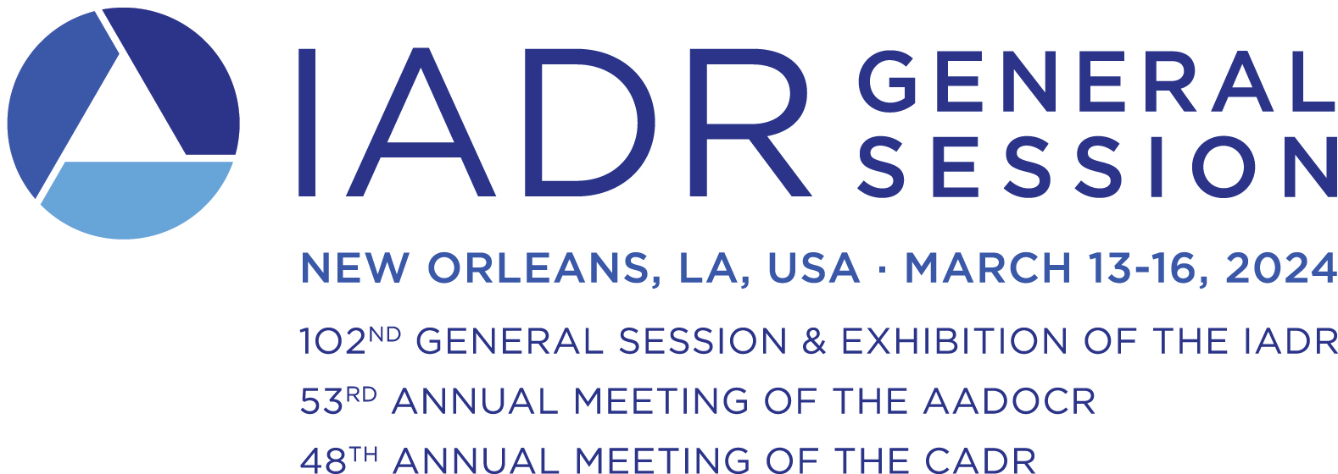
Important Dates:
Meeting Room Request Deadline December 1, 2023
Presenter Pre-registration Deadline January 11, 2024
Non-presenter Pre-registration Deadline February 1, 2024

Slide 24
Follow AADOCR on Social Media!
@AADOCR
@AADOCR
AADOCR
AADOCR
Notes:
Follow AADOCR on Social Media!

Slide 25
Contact Us
Visit www.iadr.org and www.aadocr.org for more information.
Questions about IADR/AADOCR membership, journals or meetings may be directed to research@aadocr.org or 1.703.548.0066.

